Slide 1
The IBM SPSS Statistics Environment
Prof. Andy Field

Slide 2
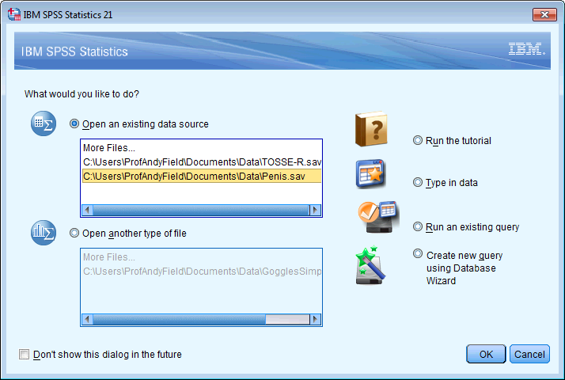
Starting IBM SPSS

Slide 3
The Data Editor

Slide 4
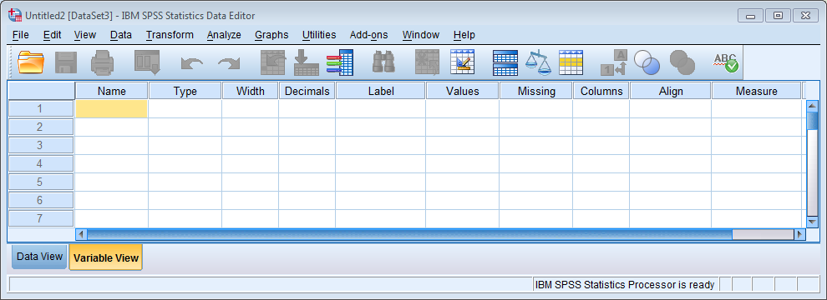
The Variable View

Slide 5
Variable Types
Numeric
Numbers (e.g. 7, 0, 120)
String
Letters (e.g. ‘Andy’, ‘Idiot’)
Currency
Currency (e.g. £20, $34, €56)
Date
Dates (e.g. 21-06-1973, 06-21-73, 21-Jun-1973)

Slide 6
Creating a String Variable

Slide 7
Creating a Date Variable

Slide 8
Creating a Coding Variable

Slide 9
The Viewer Window

Slide 10
The Syntax Window

